Slide 1
Lesson 4-Zero and First conditionals
Module 2 – Grammar Study 2

Slide 2
A zero and first conditional sentence is made up of two halves – if clause and main/result clause.
Zero Conditional
A. Form
IF clause Main/result clause
If+ sub+ v1…
Sub+ v1……

Slide 3
a. If + sub + V1… + , sub + V1…
b. Sub + V1… + if + sub + V1…
If you throw a stone in a lake, it sinks.
A stone sinks if you throw it in a lake.
You get wet if you stand in the rain.
If you stand in the rain, you get wet.

Slide 4
B. Use
i. statements about real world
ii. Refer to general truths
- If my husband gets a cold, I usually catch it.
- You get purple if you mix red and blue.

Slide 5
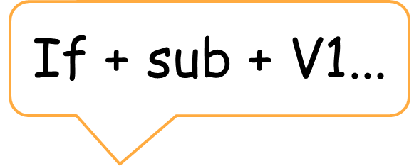
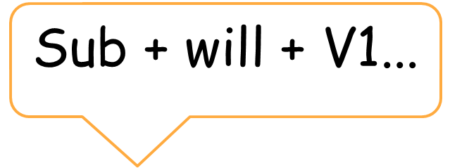
First Conditional
From
If clause Main clause

Slide 6
a. If + sub + V1… + , sub + will + V(base form)
b. Sub + will + V(b)… + if + sub + V1…
If Sreymao leaves, Dara will be sad.
Dara will be sad if Sreymao leaves.
If you don’t leave my room, I will kick you.
I will kick you if you don’t leave my room.

Slide 7
B. Use
i.Things that are possible in the present or future
ii.Things that may happen
- If it is sunny, we will go to the park.
- We will go to the park if it is sunny.

Slide 8





Thank you !
www.passerellesnumeriques.org

